Slide 1
Functions and Classes
Lecture 2

Slide 2
Agenda
Functions
Classes
Examples of classes
Encapsulation
Access specifiers
Inheritance
Single
Multilevel
Hierarchical
Multiple

Slide 3
Functions

Slide 4
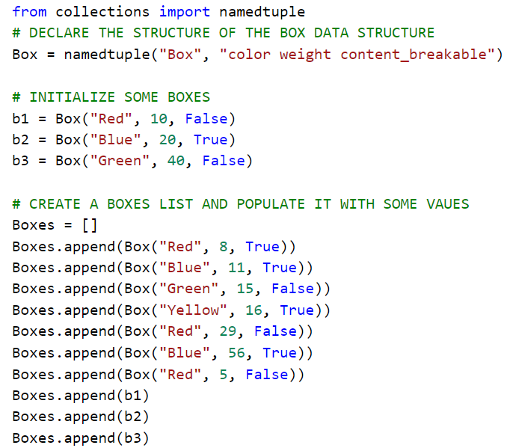
As discussed in the last lecture
We are using a light weight Data structure
namedtuple
We add these boxes to our list
Boxes
Initialized as Boxes = []

Slide 5
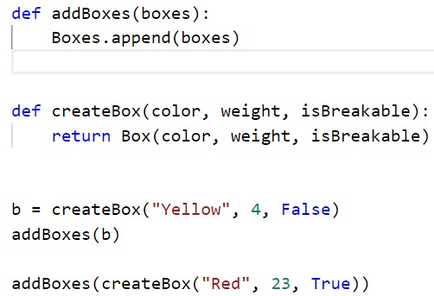
We can make the addition of items (box) to our list more intuitive
Functions are user defined procedures or mechanisms
That facilitate the creation of an intuitive behavior

Slide 6
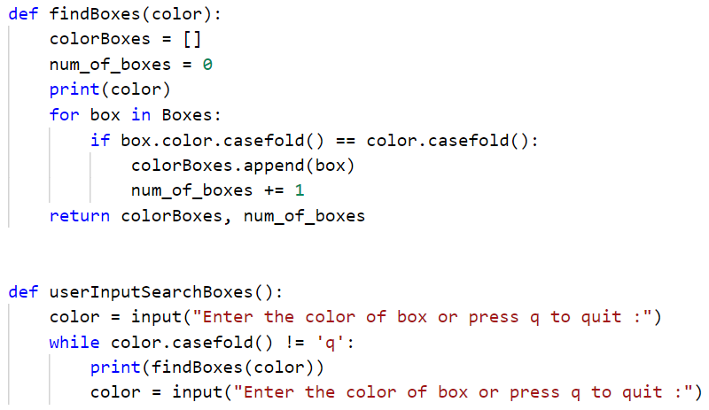
By using functions we can formulate many user defined behavior
They also provide a way to package code together so that it can be used over and over again.
findBoxes(color):
Is used to find boxes based on color
userInputSearchBoxes():
Utilizes the function findBoxes

Slide 7
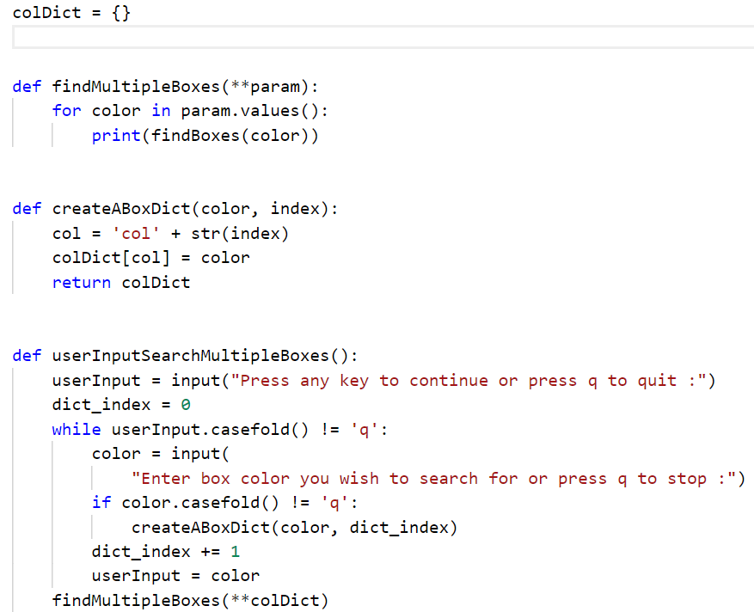
We define a function findMultipleBoxes(**params)
Which takes a dictionary as an input.
The createABoxDict method is used to create a dictionary.
The userInputSearchMultipleBoxes methods
Enables a user to create dictionary and
Then searches boxes based on color values entered by the user.

Slide 8
Classes

Slide 9
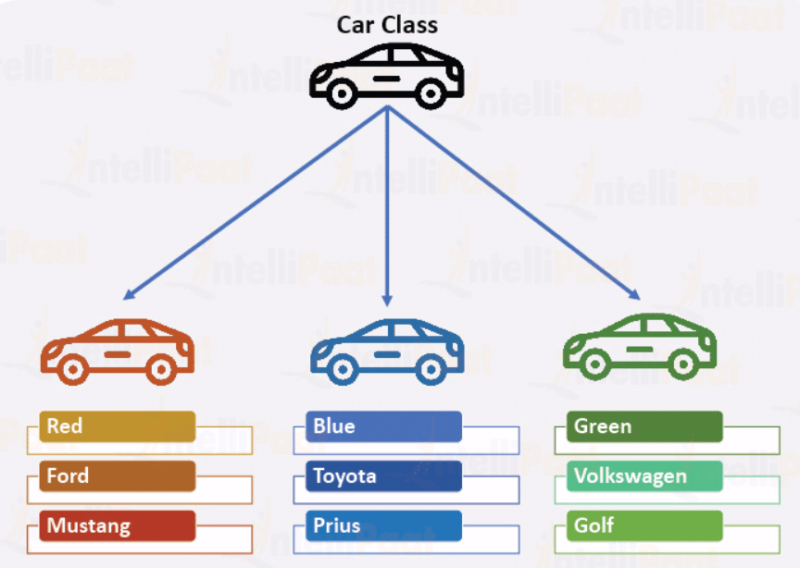
Classes are user defined data types
Containers for storing data
User (Programmer) can define them
Classes and Objects
Classes are blueprints
Objects are realization of those blue prints

Slide 10
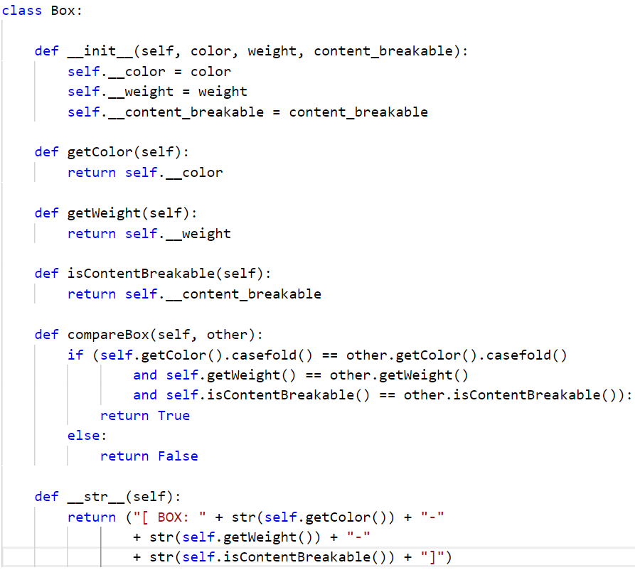
In Python we can create a class constructor by using the special __init__() method.
Every method in a python class takes a special keyword self as an argument.
Self keyword is used to refer to the object of the class.
Python supports three types of access specifiers
Access Specifiers in Python
Private
Any variable prefixed with double underscore
Protected
Any variable prefixed with single underscore
Public
No underscore

Slide 11
The class has various methods such as
Getters and Setters
getColor(self)
getWeight(self)
In this code constructor is used to set the variables.
compareBox method
Is similar to the compareTo() method in java
__str__ method
Is a special method that is called whenever we print the object of this class.
Also similar to the toString() method in java

Slide 12
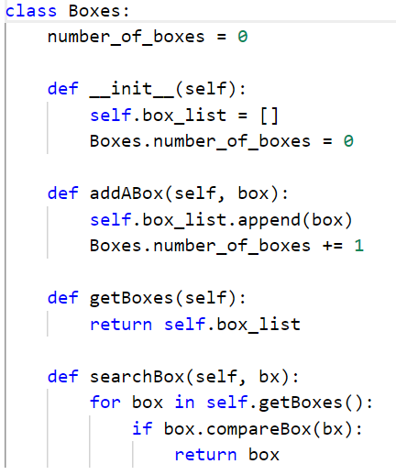
In this code we are specifying a static variable number_of_boxes.
A Static variable is always attached to the class not the object.
The searchBox method utilizes the compareBox method of the box class to search for boxes.

Slide 13
Inheritance
Single
Multilevel
Hierarchical

Slide 14
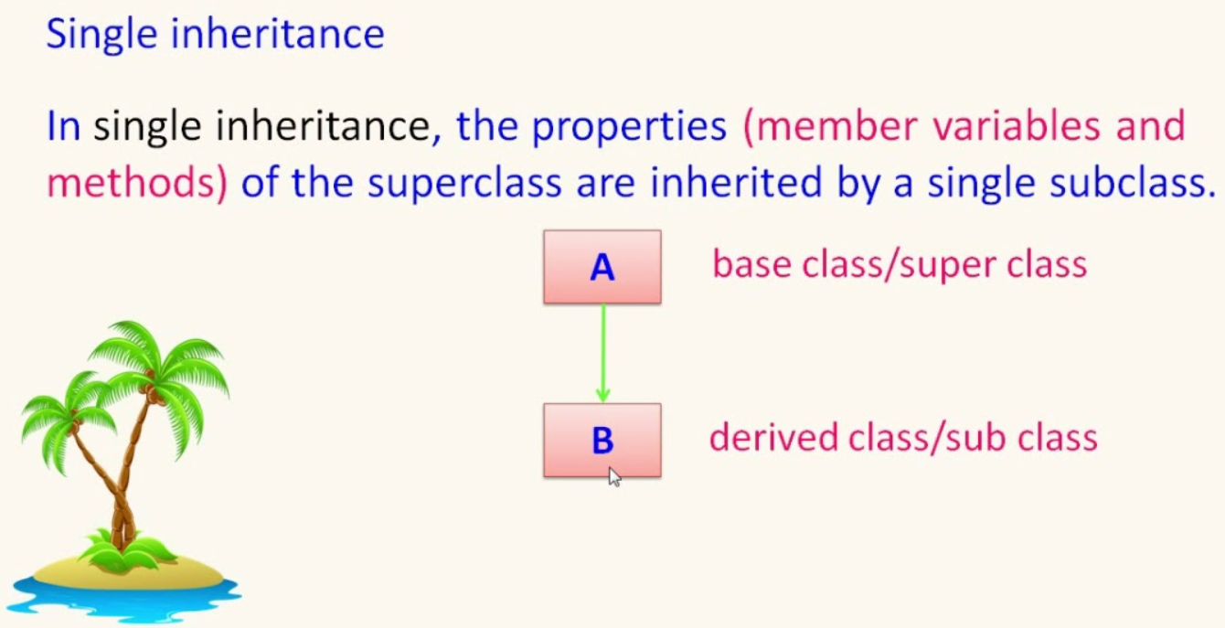

Slide 15
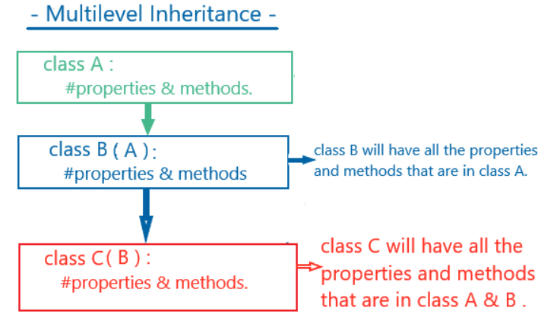

Slide 16
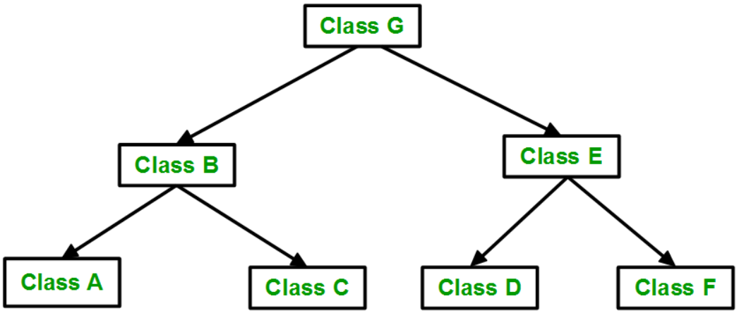
Hierarchical

Slide 17
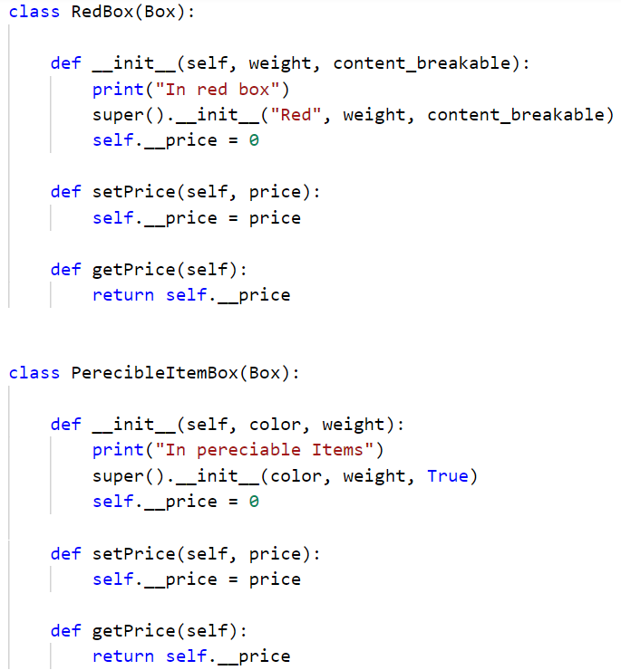

Slide 18
Multiple Inheritance

Slide 19
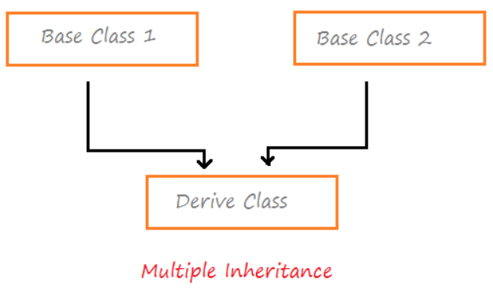

Slide 20
